Slide 1
ICS 3211: Artificial Intelligence Lecture 3: Solving problems by searching

Slide 2
Outline
Problem-solving agents
Problem types
Problem formulation
Example problems
Basic search algorithms
Blind/Exhaustive/Uninformed Search
Guided/Heuristic/Informed Search

Slide 3
Problem Solving Agents
Problem solving agent
A kind of “goal based” agent
Finds sequences of actions that lead to desirable state(s) (goal).

Slide 4
Goal Based Agent
Goal Based Agent
What the world
is like now
Sensors
Percepts
State
How the world evolves
What my actions do
Environment
What it will be like
if I do action A
Goals
What action I
should do now
Actions
Actuators

Slide 5
Goal Based Agent
Function Simple-Problem-Solving-Agent( percept ) returns action
Inputs: percept a percept
Static: seq an action sequence initially empty
state some description of the current world
goal a goal, initially null
problem a problem formulation
state <- UPDATE-STATE( state, percept )
if seq is empty then do
goal <- FORMULATE-GOAL( state )
problem <- FORMULATE-PROBLEM( state, goal )
seq <- SEARCH( problem ) # SEARCH
action <- RECOMMENDATION ( seq ) # SOLUTION
seq <- REMAINDER( seq )
return action # EXECUTION

Slide 6
Goal Based Agents
Assumes the problem environment is:
Static
The plan remains the same
Observable
Agent knows the initial state
Discrete
Agent can enumerate the choices
Deterministic
Agent can plan a sequence of actions such that each will lead to an intermediate state
The agent carries out its plans with its “eyes closed”
Certain of what’s going on

Slide 7
Well Defined Problems and Solutions
A problem is defined by providing:
Initial state
Actions and Successor Function
Goal test
Path cost
A solution is a sequence of actions leading from the initial state to a goal state

Slide 8
Example 1: Water Pouring
Given a 4 gallon bucket and a 3 gallon bucket, how can we measure exactly 2 gallons into one bucket?
There are no markings on the bucket
You must fill each bucket completely

Slide 9
Example 1: Water Pouring
Initial state:
The buckets are empty
Represented by the tuple ( 0 0 ) - (gallon 3 gallon 4)
Goal state:
One of the buckets has two gallons of water in it
Represented by either ( x 2 ) or ( 2 x )
Path cost:
1 per unit step

Slide 10
Example 1: Water Pouring
Actions and Successor Function
Fill a bucket
(x y) -> (3 y)
(x y) -> (x 4)
Empty a bucket
(x y) -> (0 y)
(x y) -> (x 0)
Pour contents of one bucket into another
(x y) -> (0 x+y) or (x+y-4, 4)
(x y) -> (x+y 0) or (3, x+y-3)

Slide 11
Example 1: Water Pouring

Slide 12
Example 2: Romania
On holiday in Romania; currently in Arad.
Flight leaves tomorrow from Bucharest
Formulate goal:
be in Bucharest
Formulate problem:
states: various cities
actions: drive between cities
Find solution:
sequence of cities, e.g., Arad, Sibiu, Fagaras, Bucharest

Slide 13
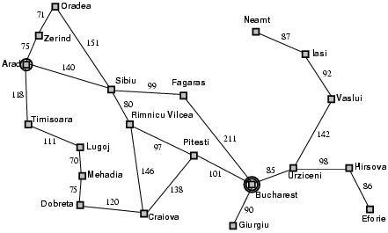
Example 2: Romania

Slide 14
Example 2: Romania
Initial State
e.g. “At Arad”
Successor Function
A set of action state pairs
S(Arad) = {(Arad->Zerind, Zerind), …}
Goal Test
e.g. x = “at Bucharest”
Path Cost
sum of the distances traveled

Slide 15
Example 3: Eight Puzzle
States:
Description of the eight tiles and location of the blank tile
Successor Function:
Generates the legal states from trying the four actions {Left, Right, Up, Down}
Goal Test:
Checks whether the state matches the goal configuration
Path Cost:
Each step costs 1
7 | 2 | 4
5 |  | 6
8 | 3 | 1
1 | 2 | 3
4 | 5 | 6
7 | 8

Slide 16
Example 3: Eight Puzzle
Eight puzzle is from a family of “sliding –block puzzles”
NP Complete
8 puzzle has 9!/2 = 181440 states
15 puzzle has approx. 1.3*10¹² states
24 puzzle has approx. 1*10²⁵ states

Slide 17
Example 4: Eight Queens
Place eight queens on a chess board such that no queen can attack another queen
No path cost because only the final state counts!
Incremental formulations
Complete state formulations
Q
Q
Q
Q
Q
Q
Q
Q

Slide 18
Example 4: Eight Queens
States:
Any arrangement of 0 to 8 queens on the board
Initial state:
No queens on the board
Successor function:
Add a queen to an empty square
Goal Test:
8 queens on the board and none are attacked
64*63*…*57 = 1.8*10¹⁴ possible sequences
Ouch!
Q
Q
Q
Q
Q
Q
Q
Q

Slide 19
Example 4: Eight Queens
States:
Arrangements of n queens, one per column in the leftmost n columns, with no queen attacking another are states
Successor function:
Add a queen to any square in the leftmost empty column such that it is not attacked by any other queen.
2057 sequences to investigate
Q
Q
Q
Q
Q
Q
Q
Q

Slide 20
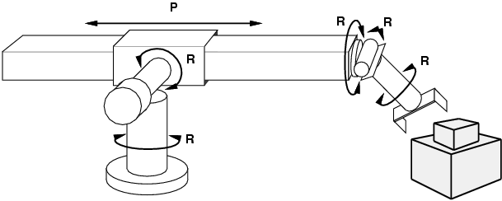
Example 5: robotic assembly
states?: real-valued coordinates of robot joint angles, parts of the object to be assembled
actions?: continuous motions of robot joints
goal test?: complete assembly
path cost?: time to execute

Slide 21
Searching For Solutions
Having formulated some problems…how do we solve them?
Search through a state space
Use a search tree that is generated with an initial state and successor functions that define the state space

Slide 22
Remark: Selecting a state space
Real world is absurdly complex
→ state space must be abstracted for problem solving
(Abstract) state = set of real states
(Abstract) action = complex combination of real actions
e.g., "Arad → Zerind" represents a complex set of possible routes, detours, rest stops, etc.
For guaranteed realizability, any real state "in Arad“ must get to some real state "in Zerind"
(Abstract) solution =
set of real paths that are solutions in the real world
Each abstract action should be "easier" than the original problem

Slide 23
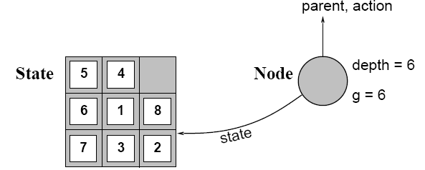
Basic terms for tree search state space
A state is a (representation of) a physical configuration
A node is a data structure constituting part of a search tree includes state, parent node, action, path cost g(x), depth
The Expand function creates new nodes, filling in the various fields and using the SuccessorFn of the problem to create the corresponding states.

Slide 24
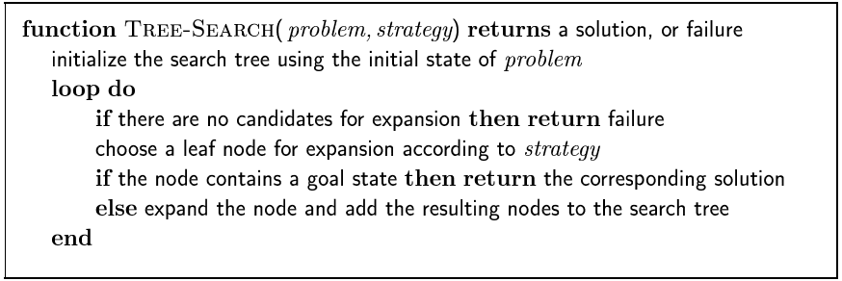
Basic concept in Searching For Solutions in a tree search space

Slide 25
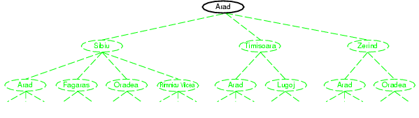
Tree search example

Slide 26
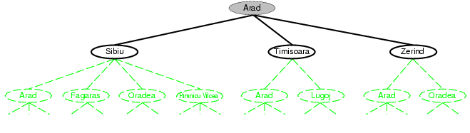
Tree search example

Slide 27
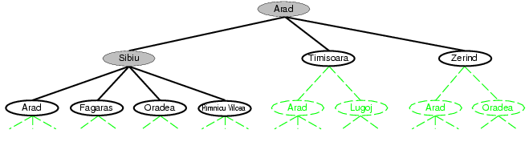
Tree search example

Slide 28
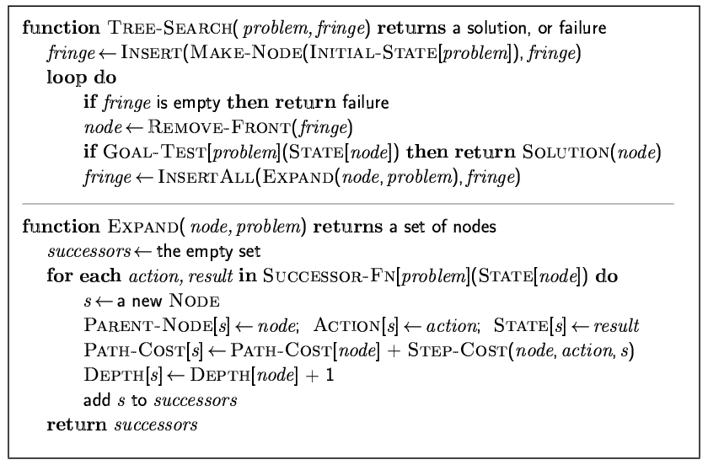
Implementation: general tree search

Slide 29
Search strategies
A search strategy is defined by picking the order of node expansion
Strategies are evaluated along the following dimensions:
completeness: does it always find a solution if one exists?
time complexity: number of nodes generated
space complexity: maximum number of nodes in memory
optimality: does it always find a least-cost solution?
Time and space complexity are measured in terms of
b: maximum branching factor of the search tree
d: depth of the least-cost solution
m: maximum depth of the state space (may be ∞)

Slide 30
Uninformed search strategies
Uninformed search strategies use only the information available in the problem definition
Breadth-first search
Uniform-cost search
Depth-first search
Depth-limited search
Iterative deepening search

Slide 31
Breadth-first search
Expands all nodes at one level before moving to the next i.e. the branch (child) nodes are visited first.
This is search strategy in which the nodes of the same level are visited first.
Expand shallowest unexpanded node
Implementation:
fringe is a FIFO queue, i.e., new successors go at end

Slide 32
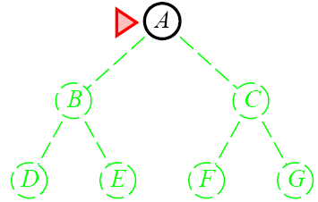
Breadth-First Search

Slide 33
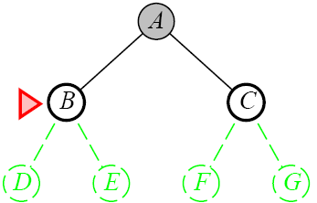
Breadth-First Search

Slide 34
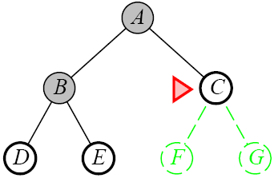
Breadth-First Search

Slide 35
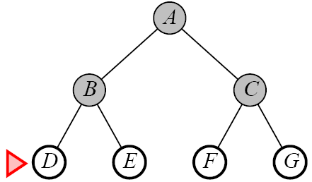
Breadth-First Search

Slide 36
Properties of Breadth-First Search
Complete
Yes if b (max branching factor) is finite
Time
1 + b + b² + … + b^{d} + b(b^{d}-1) = O(b^{d+1})
exponential in d
Space
O(b^{d+1})
Keeps every node in memory
This is the big problem; an agent that generates nodes at 10 MB/sec will produce 860 MB in 24 hours
Optimal
Yes (if cost is 1 per step); not optimal in general

Slide 37
Lessons From Breadth First Search
The memory requirements are a bigger problem for breadth-first search than is execution time

Slide 38
Uniform-Cost Search
Same idea as the algorithm for breadth-first search…but…
Expand the least-cost unexpanded node
FIFO queue is ordered by cost
Equivalent to regular breadth-first search if all step costs are equal

Slide 39
Uniform-Cost Search
Complete
Yes if the cost is greater than some threshold
step cost >= ε
Time
Complexity cannot be determined easily by d or m
Let C* be the cost of the optimal solution
O(b^{ceil(C*/ ε)})
Space
O(b^{ceil(C*/ ε)})
Optimal
Yes, Nodes are expanded in increasing order

Slide 40
Depth-First Search
Expand the deepest unexpanded node
Unexplored successors are placed on a stack until fully explored

Slide 41
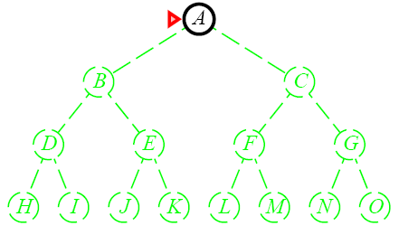
Depth-First Search

Slide 42
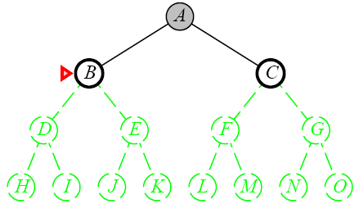
Depth-First Search

Slide 43
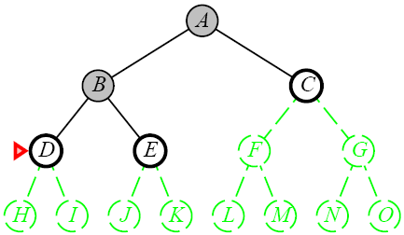
Depth-First Search

Slide 44
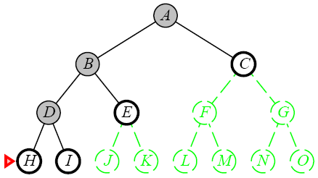
Depth-First Search

Slide 45
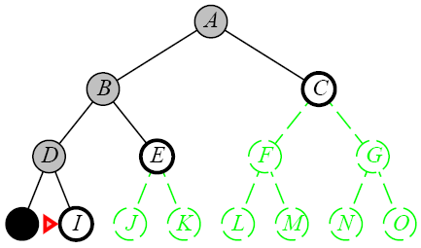
Depth-First Search

Slide 46
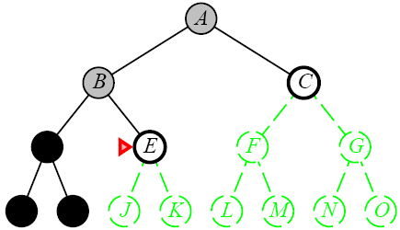
Depth-First Search

Slide 47
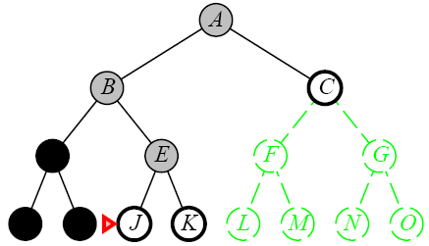
Depth-First Search

Slide 48
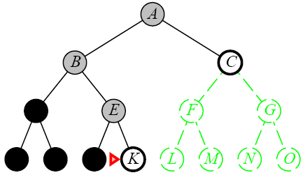
Depth-First Search

Slide 49
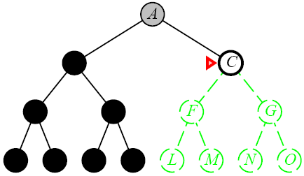
Depth-First Search

Slide 50
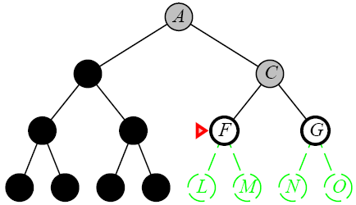
Depth-First Search

Slide 51
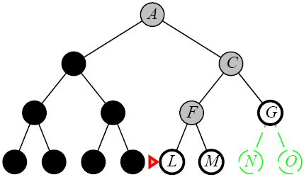
Depth-First Search

Slide 52
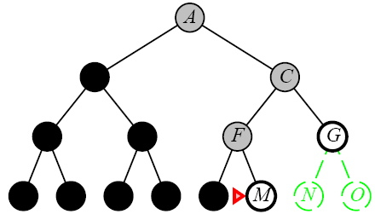
Depth-First Search

Slide 53
Depth-First Search
Complete
No: fails in infinite-depth spaces, spaces with loops
Modify to avoid repeated spaces along path
Yes: in finite spaces
Time
O(b^{m})
Not great if m is much larger than d
But if the solutions are dense, this may be faster than breadth-first search
Space
O(bm)…linear space
Optimal
No

Slide 54
Depth-Limited Search
A variation of depth-first search that uses a depth limit
Alleviates the problem of unbounded trees
Search to a predetermined depth l (“ell”)
Nodes at depth l have no successors
Same as depth-first search if l = ∞
Can terminate for failure and cutoff

Slide 55
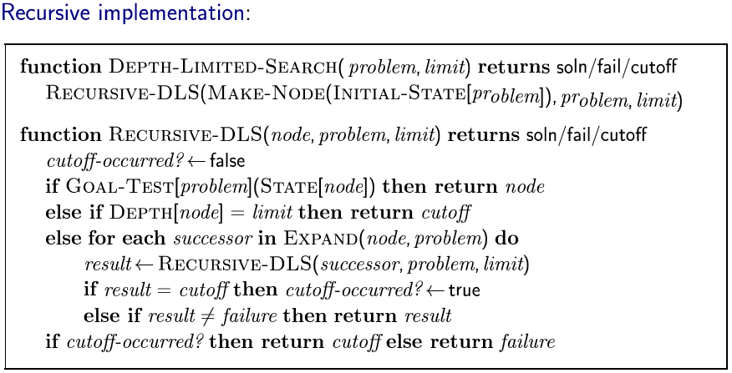
Depth-Limited Search

Slide 56
Depth-Limited Search
Complete
Yes if l < d
Time
O(b^{l})
Space
O(bl)
Optimal
No if l > d

Slide 57
Iterative Deepening Search
Iterative deepening depth-first search
Uses depth-first search
Finds the best depth limit
Gradually increases the depth limit; 0, 1, 2, … until a goal is found

Slide 58
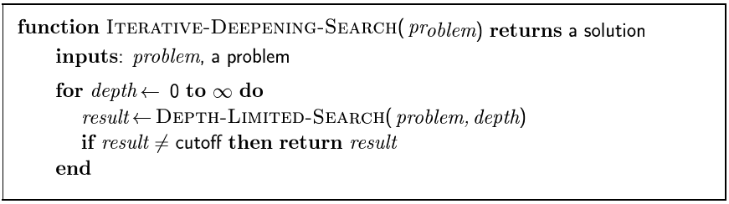
Iterative Deepening Search

Slide 59

Iterative Deepening Search

Slide 60
Iterative Deepening Search

Slide 61
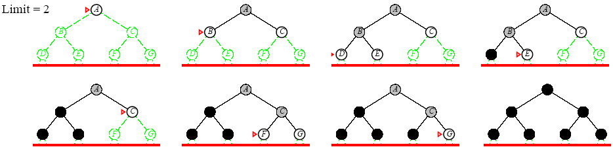
Iterative Deepening Search

Slide 62
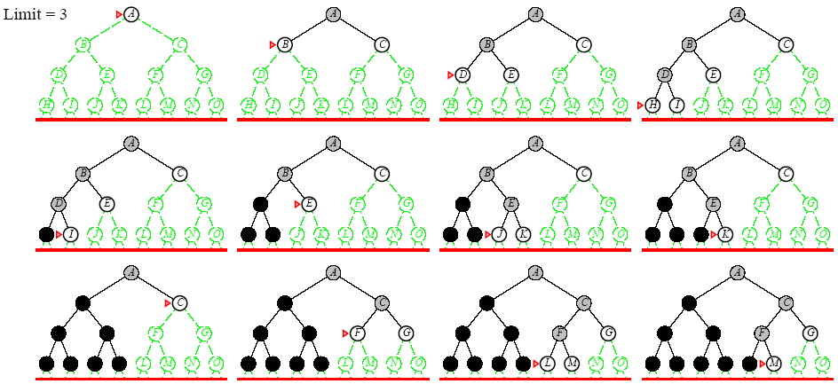
Iterative Deepening Search

Slide 63
Iterative Deepening Search
Complete
Yes
Time
O(b^{d})
Space
O(bd)
Optimal
Yes if step cost = 1
Can be modified to explore uniform cost tree

Slide 64
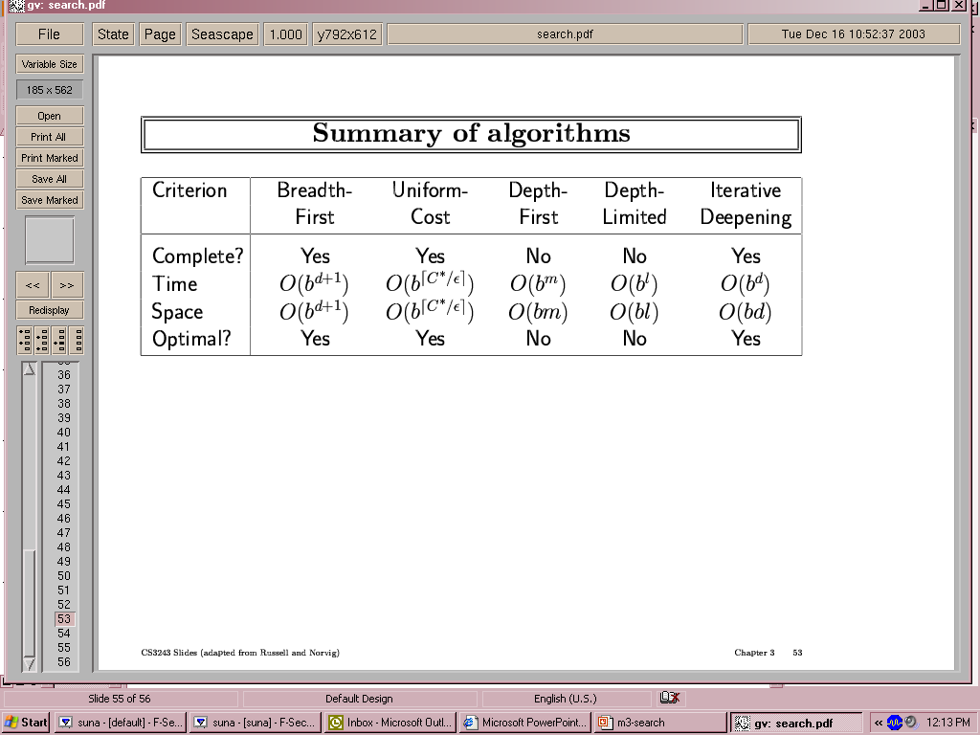
Summary of algorithms

Slide 65
Repeated states
Failure to detect repeated states can turn a linear problem into an exponential one!

Slide 66
Problems with Blind Search Strategies
Exhaustive search has the advantage of guaranteeing solutions if they exist.
However, exhaustive search has some problems associated with the need to visit all states at times.
One problem is about combinatorial problems associated with some search cases. At times the number of possibilities rise and demands on storage and processing cannot be met.
The other problem is that the state space can be extremely large such that complete search is time consuming. Sometimes the state space can be inexhaustible, in that it is difficult to enumerate.

Slide 67
Summary-Uninformed
Problem formulation usually requires abstracting away real-world details to define a state space that can feasibly be explored Variety of uninformed search strategies Iterative deepening search uses only linear space and not much more time than other uninformed algorithms

Slide 68
Informed search algorithms

Slide 69
Outline
Best-first search
Greedy best-first search
A* search
Heuristics
Local search algorithms
Hill-climbing search

Slide 70
Review: Tree search
A search strategy is defined by picking the order of node expansion

Slide 71
Informed Search Strategies
Guided search is one solution to the problems associated with exhaustive search.
The knowledge about the problem domain is used to guide the search mechanism thus enabling it to avoid wrong options.
Heuristics are rules that apply most of the time but not all the time.
Definition:
Searches that use a heuristic function to direct the search towards the goal.
Heuristic Function (h(n))
A function that calculates the cost of reaching the goal state from the node n.

Slide 72
Best-first search
Idea: use an evaluation function f(n) for each node
Provides estimate of "desirability"
Expand most desirable unexpanded node
Implementation:
Order the nodes in fringe in decreasing order of desirability

Slide 73
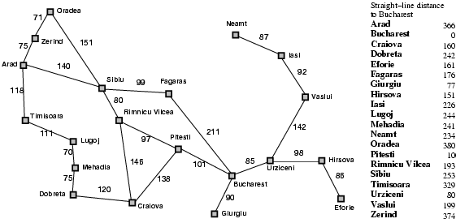
Romania with step costs in km

Slide 74
Greedy best-first search
Evaluation function f(n) = h(n) (heuristic)
= estimate of cost from n to goal
e.g., h_{SLD}(n) = straight-line distance from n to Bucharest
Greedy best-first search expands the node that appears to be closest to goal

Slide 75
Greedy best-first search algorithm
QUEUE-path only containing the root
WHILE QUEUE is non-empty AND goal not reached DO
Remove the first path from the QUEUE
Create new paths (to all children)
Reject new paths with loops
Add paths and sort the entire QUEUE
IF goal reached THEN success ELSE failure

Slide 76

Greedy best-first search example

Slide 77
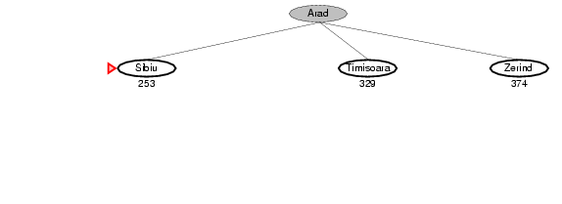
Greedy best-first search example

Slide 78
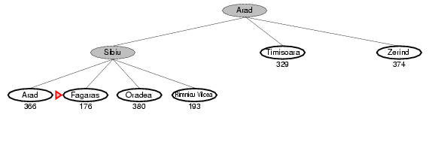
Greedy best-first search example

Slide 79
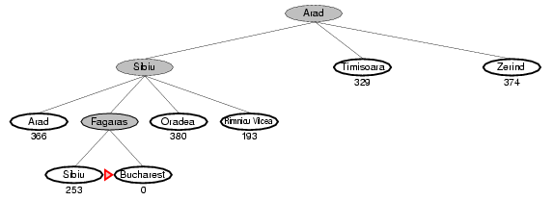
Greedy best-first search example

Slide 80
Properties of greedy best-first search
Complete? No – can get stuck in loops, e.g., Iasi → Neamt → Iasi → Neamt →
Time? O(b^{m}), but a good heuristic can give dramatic improvement
Space? O(b^{m}) -- keeps all nodes in memory
Optimal? No

Slide 81
A* search
Idea: avoid expanding paths that are already expensive
Evaluation function f(n) = g(n) + h(n)
g(n) = cost so far to reach n
h(n) = estimated cost from n to goal
f(n) = estimated total cost of path through n to goal

Slide 82
A* search (2)
Adds a "breadth-first" component to the evaluation function by including the g term
Ranks nodes on the search frontier by the estimated cost of a solution that goes from the start node through the given node to a goal node. That is, g(n) is the cost from the start node to node n, and h(n) is the estimated cost from node n to a goal.

Slide 83

A* search example

Slide 84
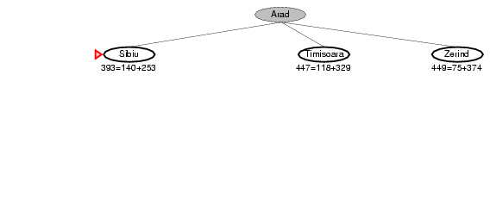
A* search example

Slide 85
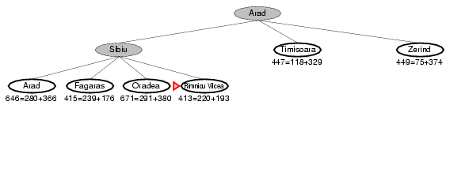
A* search example

Slide 86
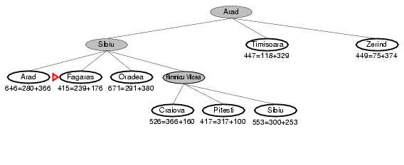
A* search example

Slide 87
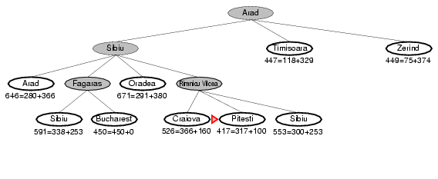
A* search example

Slide 88
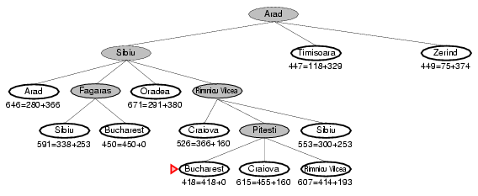
A* search example

Slide 89
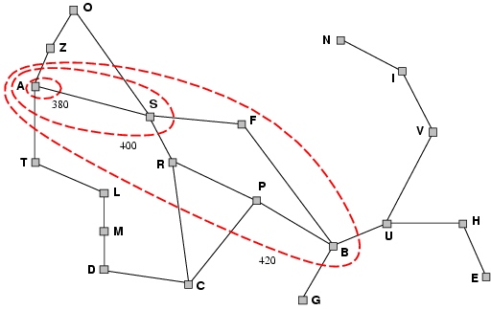
Optimality of A*
A* expands nodes in order of increasing f value
Gradually adds "f-contours" of nodes
Contour i has all nodes with f=f_{i}, where f_{i} < f_{i+1}

Slide 90
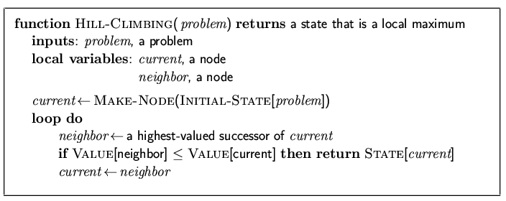
Hill-climbing search
"Like climbing Everest in thick fog with amnesia"

Slide 91
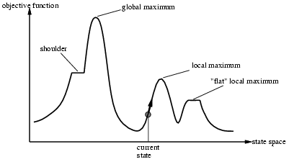
Hill-climbing search
Problem: depending on initial state, can get stuck in local maxima

